Slide 1
Unit 4 Solving Linear Equations
Algebra 1

Slide 2
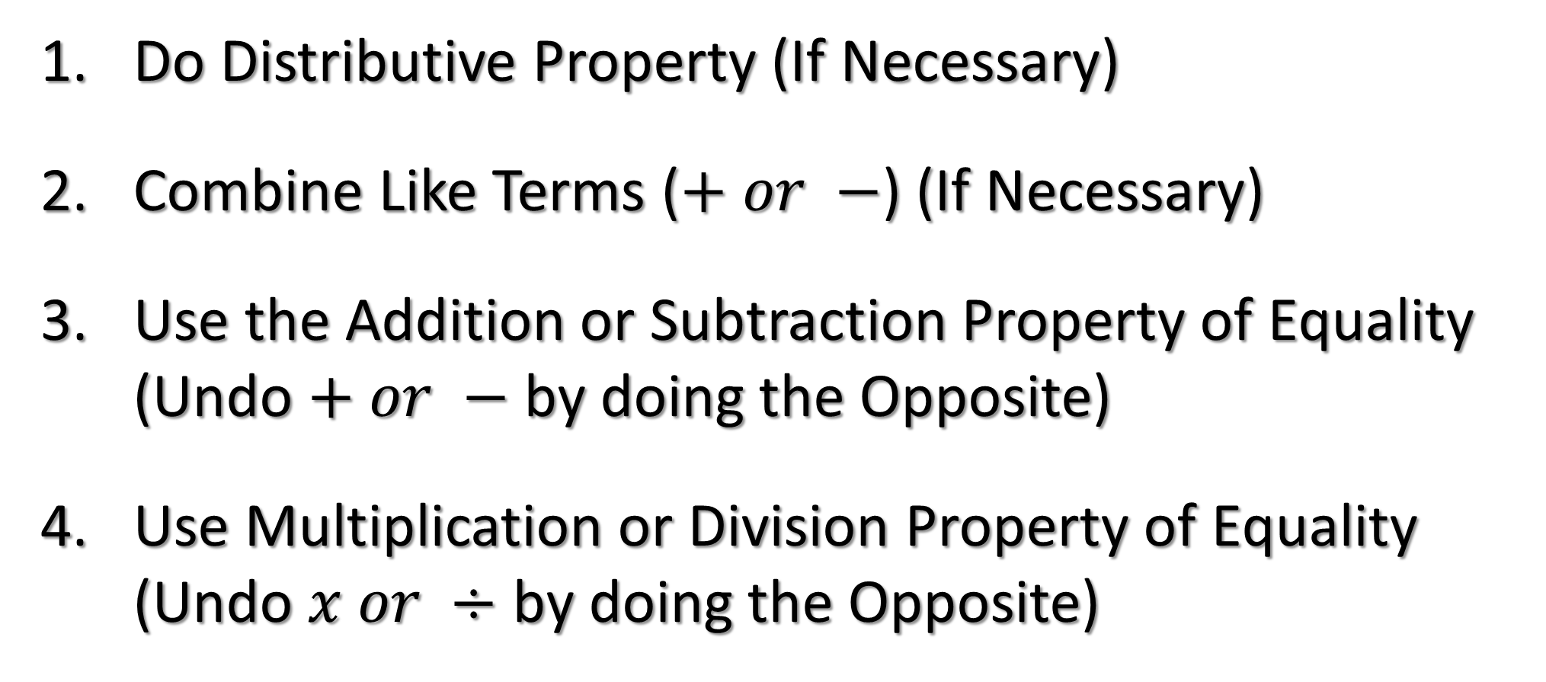
Steps for Solving an Equation
Do Distributive Property (If Necessary)
Combine Like Terms ($+ or −$) (If Necessary)
Use the Addition or Subtraction Property of Equality (Undo $+ or −$ by doing the Opposite)
Use Multiplication or Division Property of Equality (Undo $x or ÷$ by doing the Opposite)

Slide 3
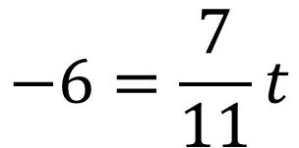
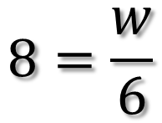
Solve for the Variable
$$10=x+6$$
$$−13=3p$$
$$8=\frac{w}{6}$$
$$−6=\frac{7}{11}t$$

Slide 4
Solve the Equation
$$−6=−g+8$$
$$7.2x+8.5=17.4$$

Slide 5
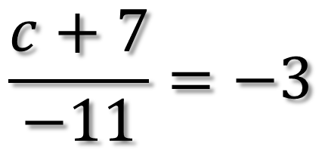
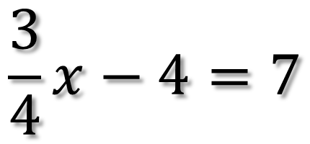
Solve the Equation
$$\frac{3}{4}x−4=7$$
$$\frac{c+7}{−11}=−3$$

Slide 6
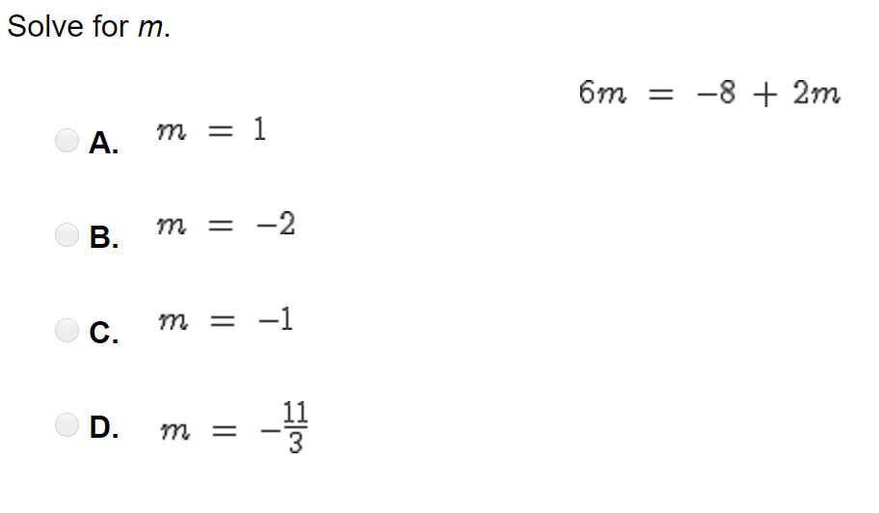
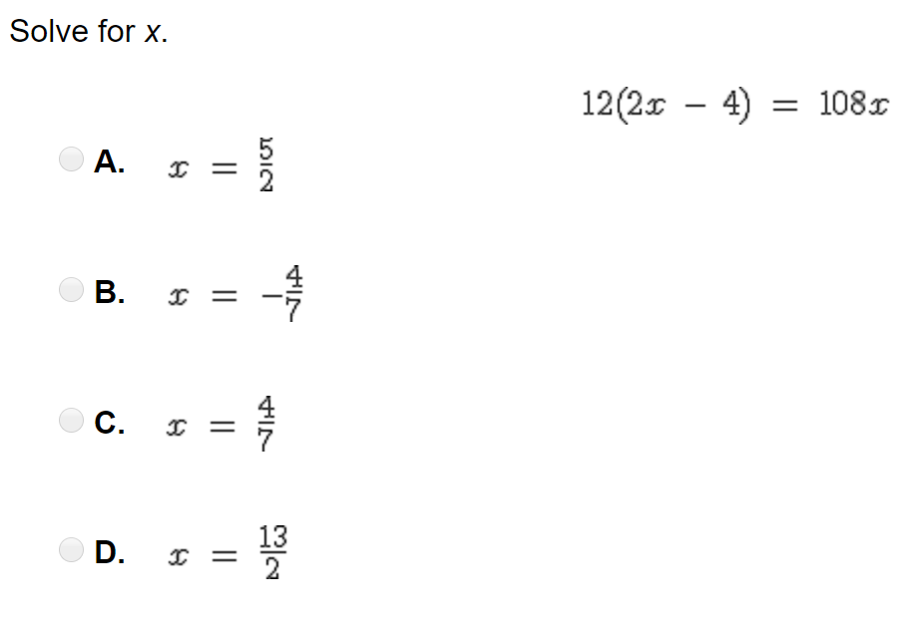
Solve the Equation

Slide 7
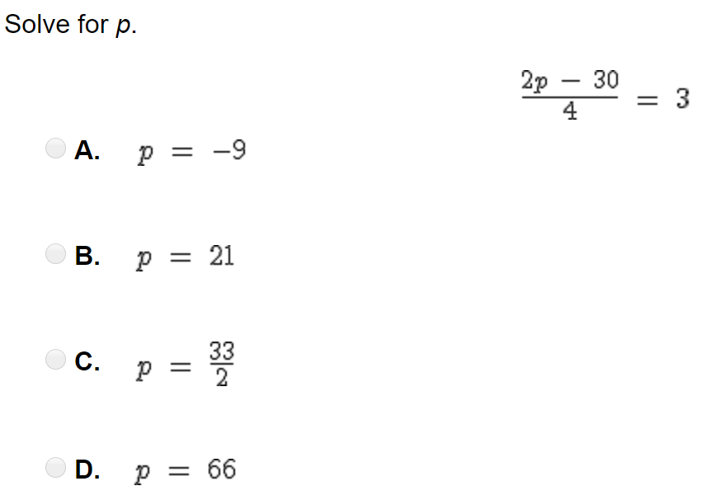
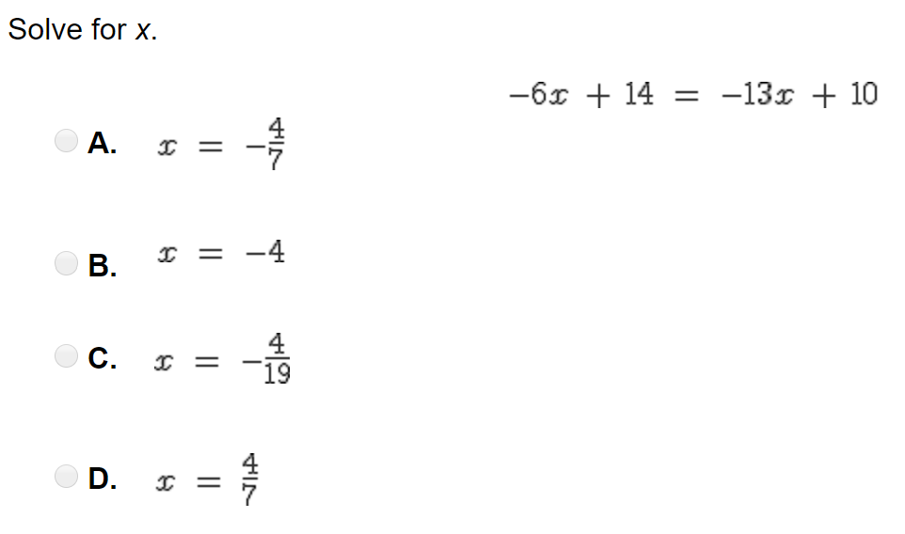
Solve the Equation

Slide 8
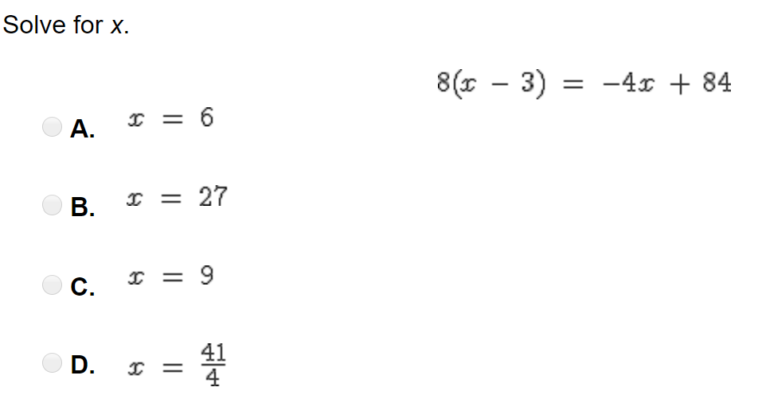
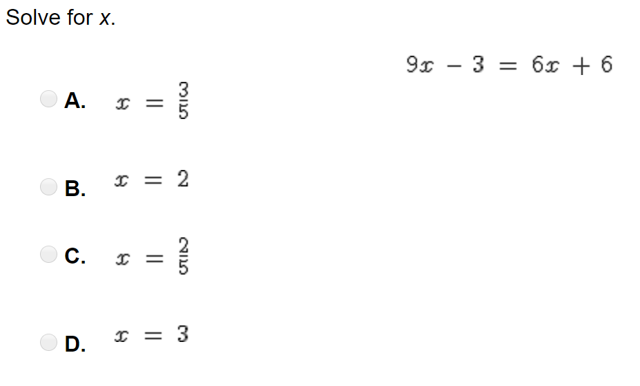
Solve the Equation

Slide 9
Solve the Equation
2($x+4)−5(x−2)=36$
2$x+4=−4x+5x−3$

